Slide 1

QUALITY ALLOY STRATEGY
Source: Columbia Business School
Team 7 - CASTRO
11/24/19
Andrew D’Armond | Andrea Galura | Aboubacar Kouyate | Dong Hoon Lee | Orlina Machado

Slide 2






Company Overview
Small US-based alloy distributor to industrial manufacturers
Experts in market niche
Unpredictable customer purchases
Small quantities
Customized sizes
Same or next day shipping
Notes:
Unpredictable customer purchases based on specific jobs they have in hand
Created new website to extend reach in USA, Europe and especially Asia

Slide 3
Problem Statement
Quality Alloy is currently incapable of developing a website that generates consumer interest, builds customer retention, and furthers brand recognition.
Their revenues and profits decreased despite website traffic increase of 38% during the promotion. Also, volatility of QA’s customers do not sustain revenues.

Slide 4
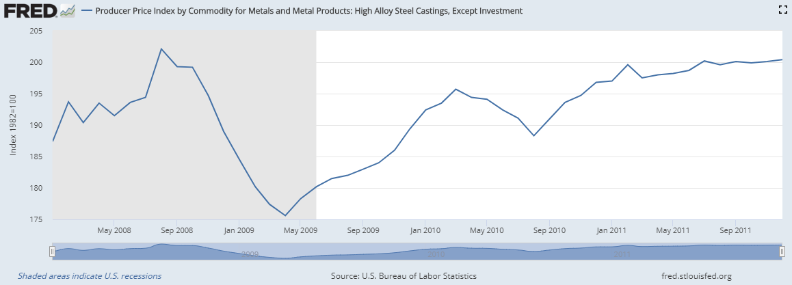
Industry Analysis
Source: https://fred.stlouisfed.org/series/WPS101508
Notes:
Weight of alloy sold during the promotion declined by 24.87% from the pre-promotion period. As a result, sales revenues and profits are declining considerably during the promotion campaign. In addition, we see an average of 20% drop in product sold for the 3 preceding years (2005, 2006, 2007).

Slide 5
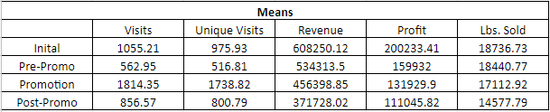
Means over the Four Periods
Increasing visits
during the promotion
Revenue is decreasing even with promotion

Slide 6
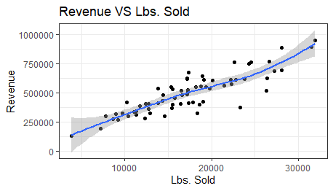
Correlation of Revenue & Pounds Sold
Strong relationship Correlation : 0.87
Sales and revenue move together

Slide 7
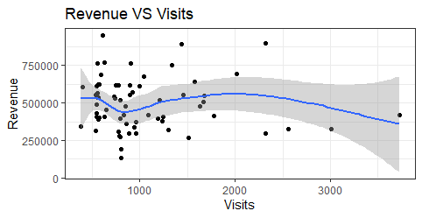
Correlation of Revenue & Visits
Low relationship Correlation : - 0.06
Website visits did not drive sales

Slide 8




Data Conclusions
Generated 3x total & unique visits during promo
Low conversion rate in promo period
Lowest totals in post promo period
Negative correlation between number of visits to actual profits
Notes:
receiving exclusively new customers, the revenue generated in total is low
assumption that new visitors are unhappy with the inability to order online and make a request to be contacted to make a specific purchase.
lowest totals for the revenue, profits, and lbs sold was the post promo period
- QA generated a 65% increase in visits on its website post promotion

Slide 9
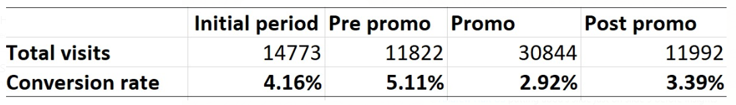
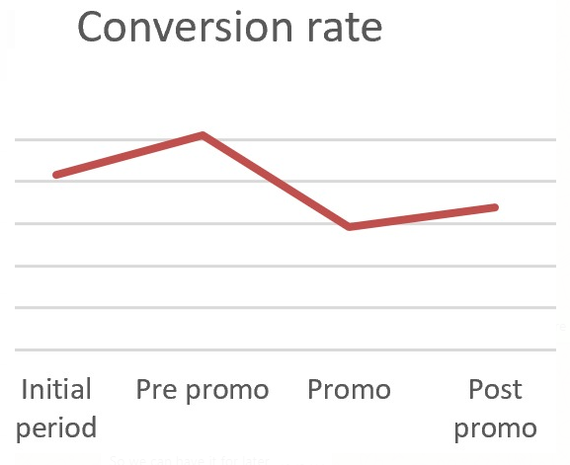
Data Conclusion
Notes:
We converted our visitors to an addressable market. then we divided by the total number of visitors per period.

Slide 10



Business Insights
5% average of visitors converts to customers
&
decline to 3% of potential visitors in promo period
38% traffic increase in post-promo period
Weight of alloy sold during promo declined by 24.87% from pre-promo period
Notes:
- successful impact during the promotion, but revenues and profits did not increase in accordance with traffic increase
decrease of 2 point from the pre-promotion period
sales revenues and profits are declining considerably during the promo. In addition, we see an average of 20% drop in product sold for the 3 preceding years (2005, 2006, 2007).

Slide 11


Business Insights
Roughly 41, 000 visits were from Google (about 60%)
Creation of a new business opportunity in South America
Notes:
Need to elaborate on the impact of the traffic source of google which is that they must learn to shape their online presence and not rely on the powers of the google platform (Whether from a traditional search engine or AdWords referral sites)
We believe that the business should look at the potential marketplace in south america and begin target research

Slide 12



Recommendations
Create account tab with features for better customer interface
Improve brand recognition by partnering with sector-specific websites
Streamline manufacturing process to avoid a bottleneck in supply chain
Notes:
- Create an account tab with features allowing users to input their orders. Faster reorders, new orders and customer preferences that allow greater interface from customers to businesses.
- associate themselves on websites specifically industrial union websites such as UAW, United Steel Workers, United Food and Commercial Workers. To generate business interests, develop an online presence that allows partners to see influence in the sector. This will further their business strategy by incorporating new customers while creating stronger brand recognition in their sector.
- with an expectation of orders increasing in the near future

Slide 13
APPENDIX

Slide 14
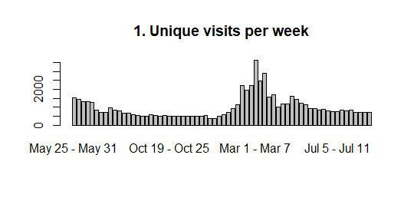
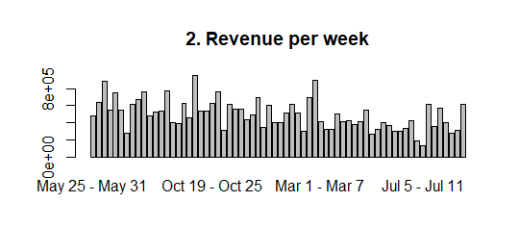
Unique Visits & Revenues over time

Slide 15
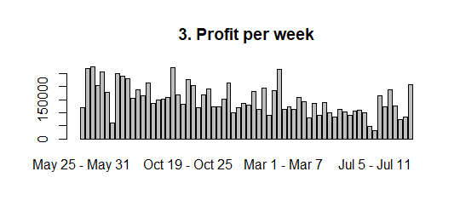
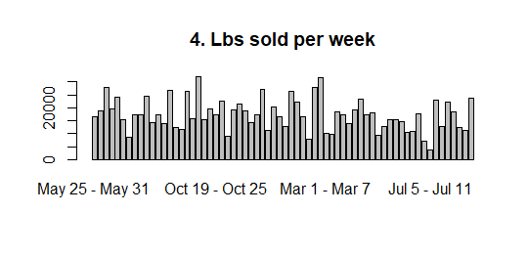
Unique Profits & Pounds sold over time

Slide 16
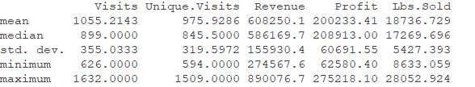
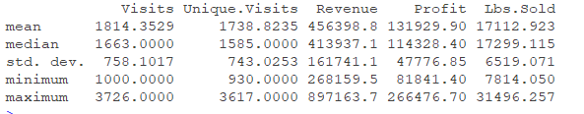
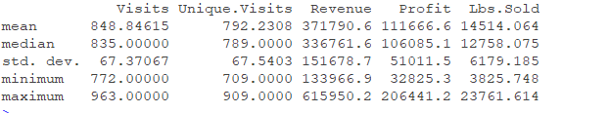
Summary of Initial, Promo & Post – Promo Periods

Slide 17
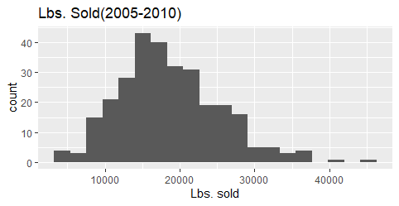
Modelling Data

Slide 18
Findings
The website generated over 3 times the total visits and unique visits during the promotion. However, the company had a negative correlation between the number of visits to the actual profit the company generated.
The most pounds sold, revenue generated and highest profit-to-visits ratio was in the initial phase.
The most connected values found during our analysis were the visits and unique visits, wherein QA is receiving exclusively new customers. They didn't gain a high conversion rate as seen in the promotion period by the revenue generated in total.
We can make the assumption that new visitors are unhappy with the inability to order online and had to make a request to be contacted to make a specific purchase.
Following the promotion, the lowest totals for the revenue, profits, and lbs sold was the post promotion period. However, QA does generate a 65% increase in visits on its website post promotion.

